Slide 1
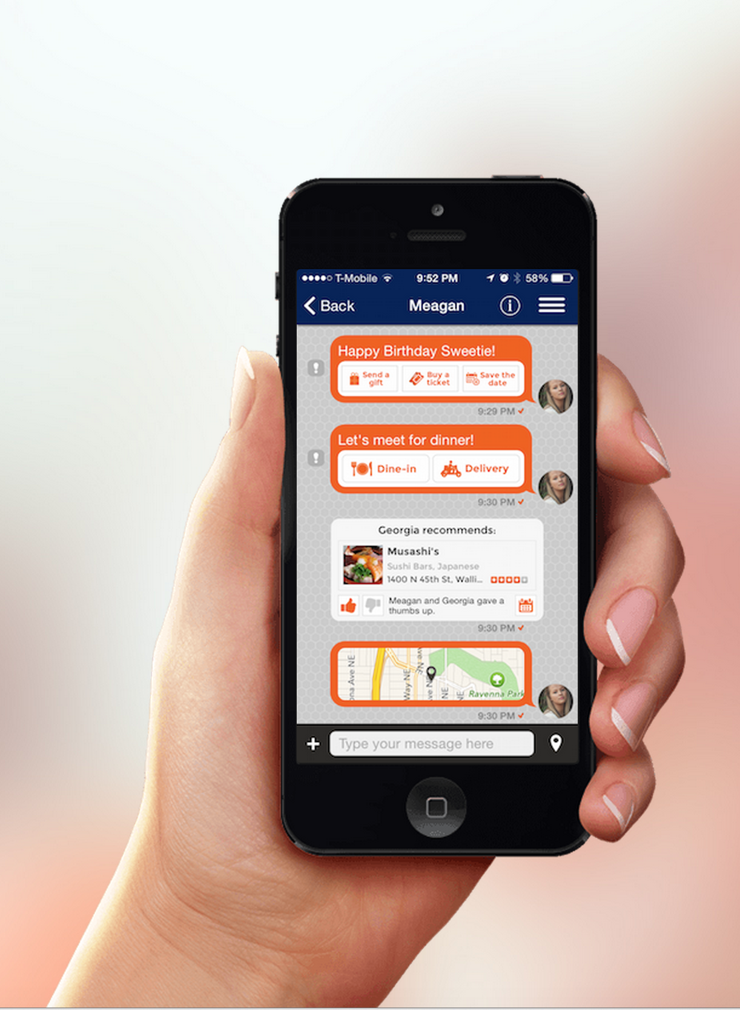
Dokoji offers real-time, localized recommendations in the context of your conversation.
Dining Shopping Entertainment
Turning conversation into better decisions.

Slide 2
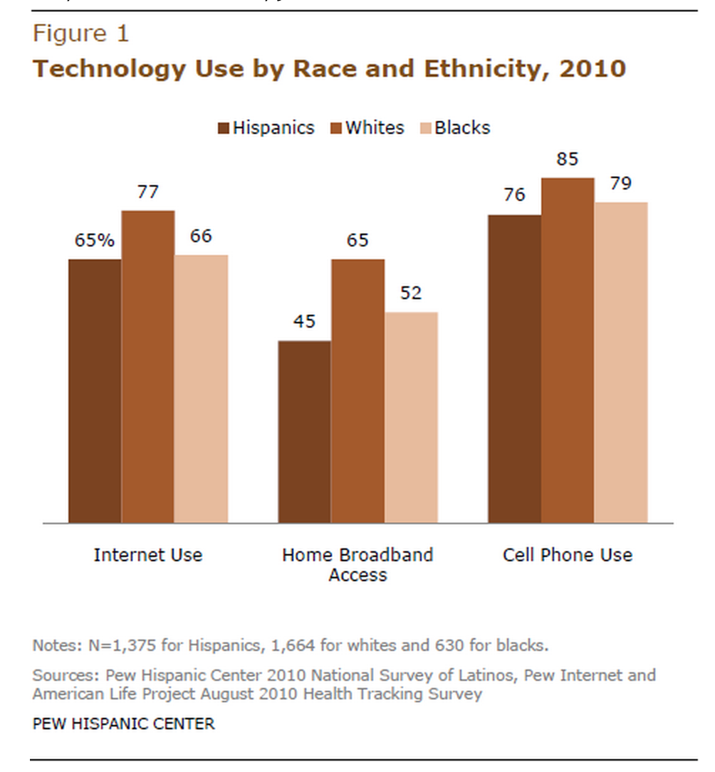

People across races and SES do not have equitable access to broadband or tech literacy ….but are equally on their phones.
PROBLEM
How can we make it easier to find green,
safe, interesting routes to
meet friends or go home?

Slide 3
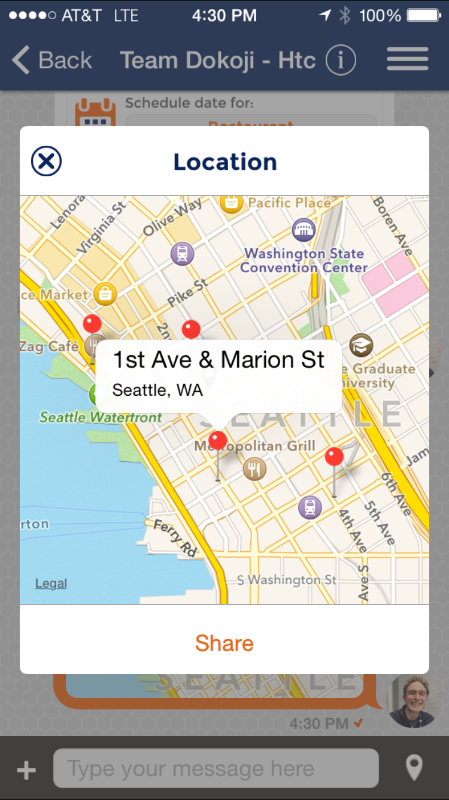
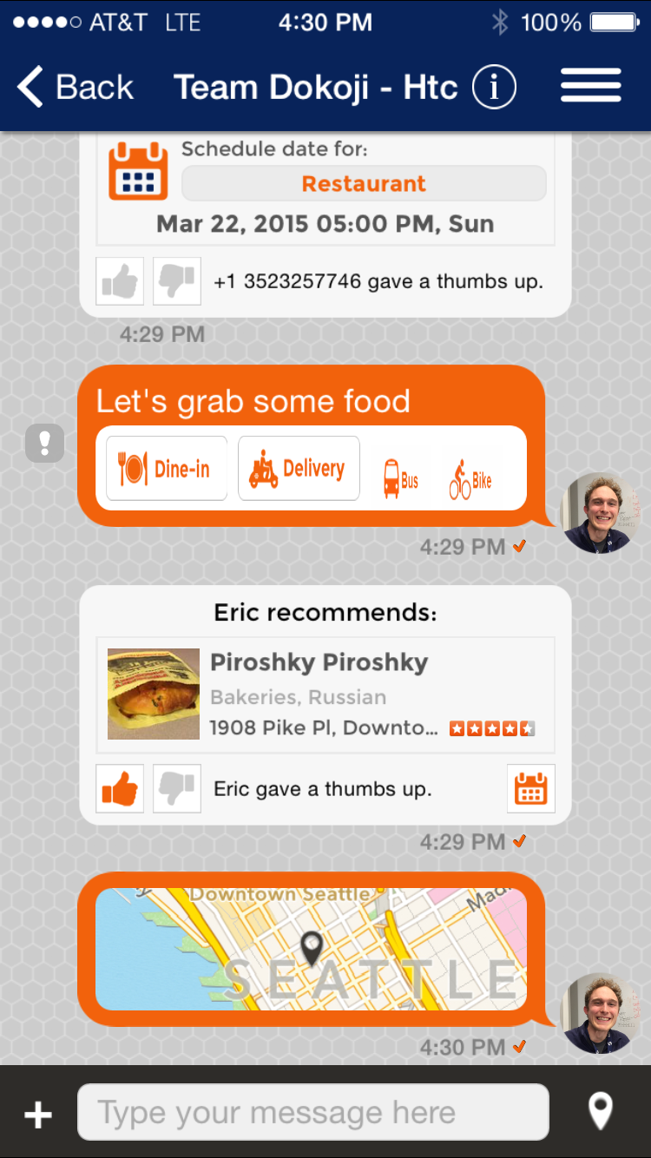
SOLUTION
Real-time, localized transportation info in context of natural text conversations on the phone.
DEMO
Dokoji conversational platform already exists
Added route info during hackathon
One Bus Away, Pronto, Path Impact (WSDOTpermits)

Slide 4
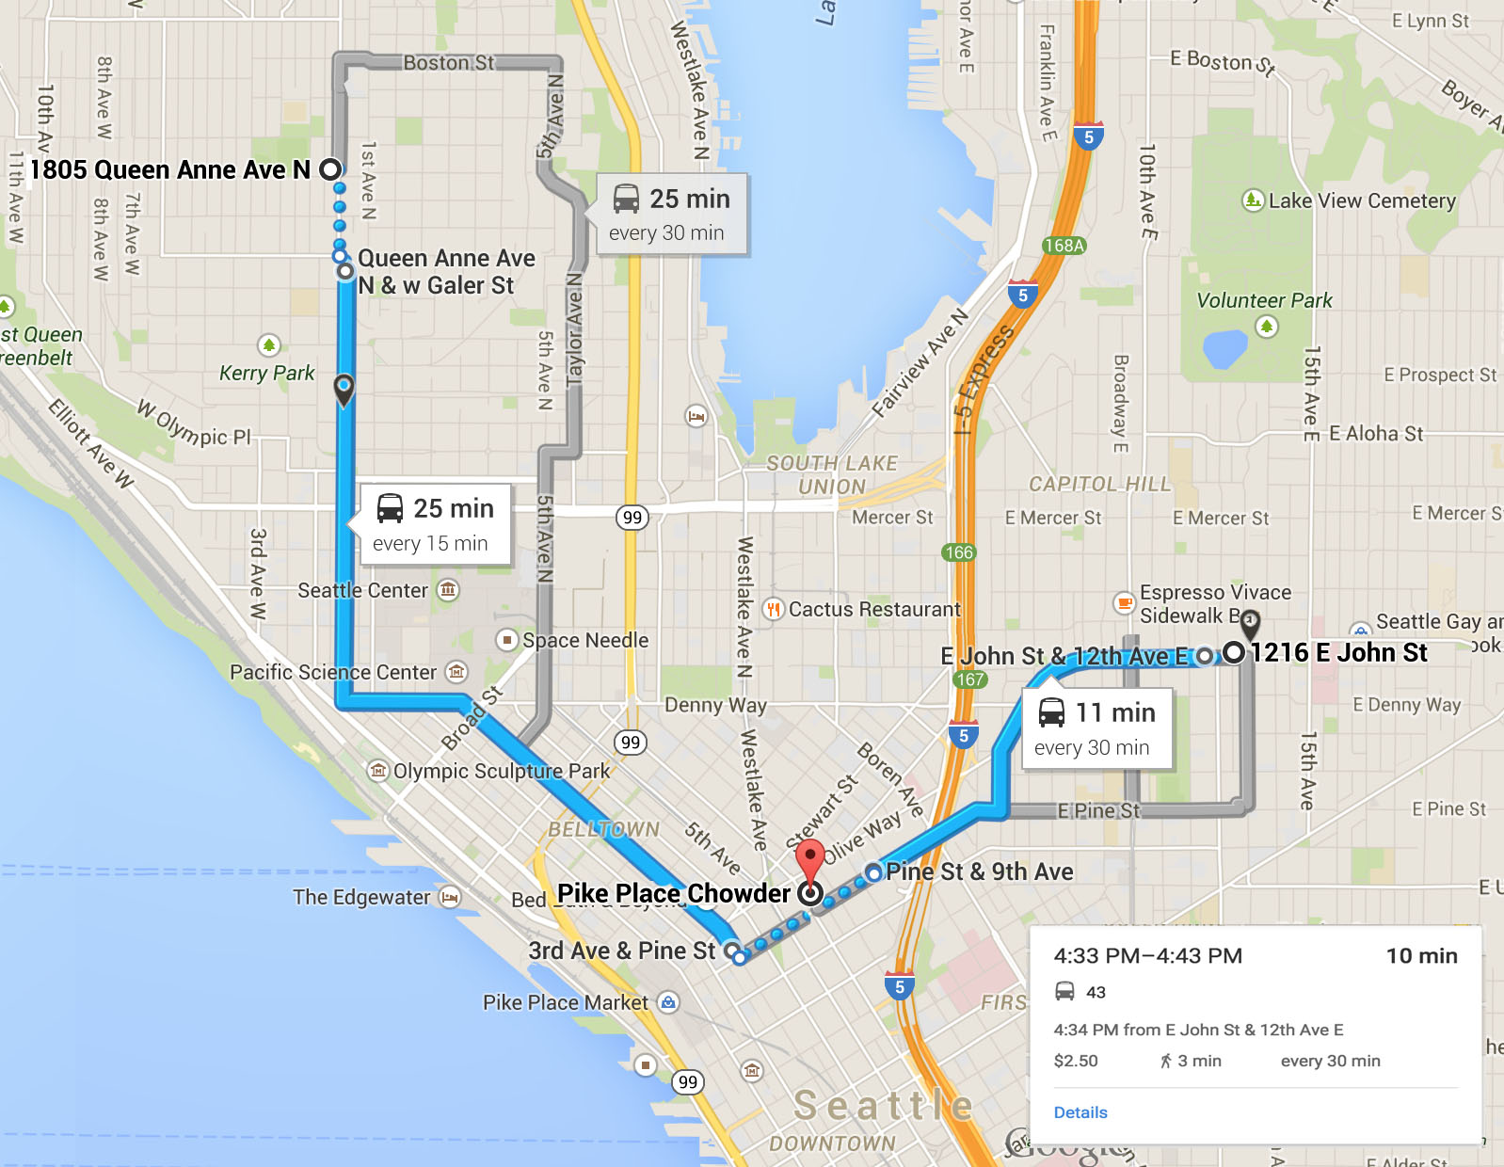

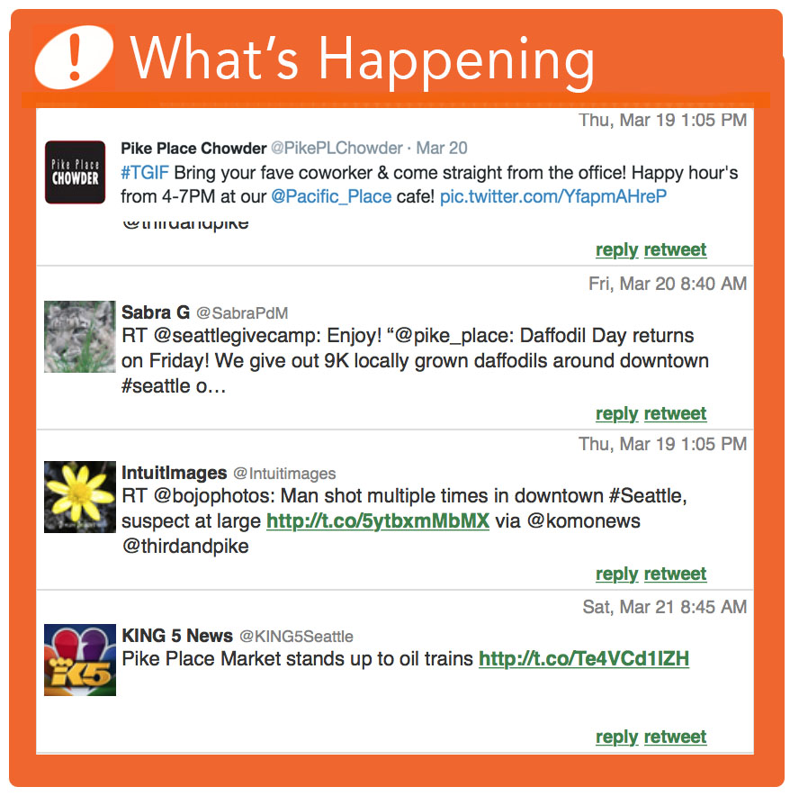
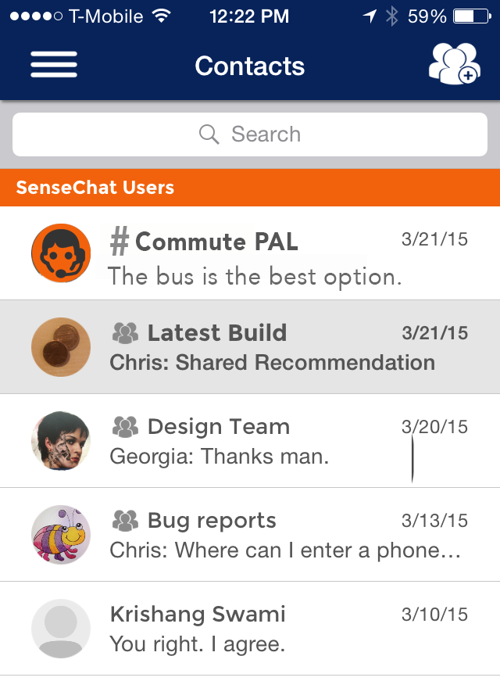
IMPACT
NATURAL, FUN, & EASY =
Behavioral change
Increased digital equity
Route information
CONCEPTS
#Commute PAL, helps you get home
Trending in social media and open data

Slide 5
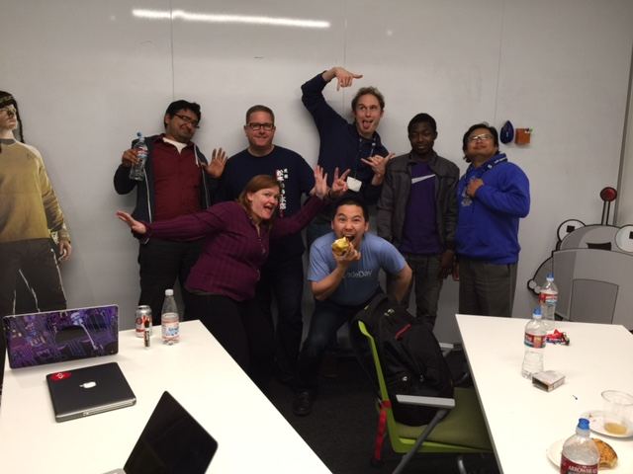
IMPLEMENTATION & SUSTAINABILITY
Jon Madamba Program Management
Chris Wilson Marketing
Shubham Shukla Dev Lead
Budi Mulyo Dev
Eric Mentele Dev
Iliass Tiendredbeogo Dev
Shelly Farnham, Data Analytics, UX
Call to Action
MVP in app store soon, help with testing, give feedback
Partner with us (City of Seattle, SDOT, Socrata, One Bus Away,
community groups, etc.) for API integration and outreach
Give us advice on funding, operations, scalabilty
Help us test our app!
Go to http://dokoji.com and fill out contact form.

